Slide 1
TOPIC B2:
PROGRAMMING
LESSON B2-4
LOOPS

Slide 2
AGENDA
Warm-up Question
For Loop
While Loop
Do While Loop
Programming Assignment
NOTE!
Have a way to take notes and a way to write code available for this lesson

Slide 3

THE WARM UP QUESTION
Create a program that takes in a number from the user and outputs “Fizz” if the number is divisible by 3, “Buzz” if the number is divisible by 5, or “FizzBuzz (one line) if the number is divisible by both 3 and 5.

Slide 4
THE WARM UP ANSWER
num = int(input("Type in a number: ")) if(num % 5 == 0 and num % 3 == 0): print("FizzBuzz") elif(num % 5 == 0): print("Buzz") elif(num % 3 == 0): print("Fizz") else: print("No fizzbuzz for you >:(")

Slide 5
THE NEED FOR LOOPS
What happens if we want to run a certain line of code multiple times?
Say, we want to do something 100 times
Is it reasonable to ask the programmer to write this line that much?
Copy/Pasting will help with repetition
What’s the drawback to doing this?

Slide 6
THE NEED FOR LOOPS
Drawbacks:
Takes up more space on the computer
If the program needs to be changed, each line will need to be changed manually
Makes the code harder to navigate the larger it gets
May slow down the computer as you try to write the code

Slide 7
LOOPS
Loops provide an effective way to execute a block of code repeatedly
There are many instances where this is useful to use, and we’ll look at a few types of loops today
For Loop
While Loop
Do While Loop
These are NOT the only kinds of loops that exist, but they will make up a majority of our uses

Slide 8
FOR LOOPS
For Loops are designed to run for a specific number of iterations
You will do these only when you know how many times you want a loop to run
These are also known as Count-Controlled Loops
for i in range(0,200): print("Hello " + str(i))

Slide 9
FOR LOOPS
Notice that the code on the right will include the 0 when it prints out, but only goes up to 199
This is because we loop until i == 200, then stop
This represents 200 iterations in the range of 0-199
What would we do to get it to print 1-200?
for i in range(0,200): print("Hello " + str(i))

Slide 10
FOR LOOPS
You can access and re-assign variables from outside of the loop while inside of the loop
You can also access variables created inside of the loop outside of the loop in Python, which is not a common feature among languages
x = 5 for i in range(1,6): x = x * i if(i == 1): y = 1 y = y + 1 print(x) print(y)

Slide 11
PRACTICE
Write a program that will print out every even number from 0 to 100

Slide 12
PRACTICE
We can actually do this without using an if statement inside of our loop as well
Adding a third number to our range indicates our step size, which indicates how many i increases by with each iteration
a = 10 if(a > 5): a = a - 2 print(a)

Slide 13
BACK, BACK, BACK IT UP
This ironically allows us to iterate backwards over a range as well
for i in range(100, 0, -2): print(i)

Slide 14
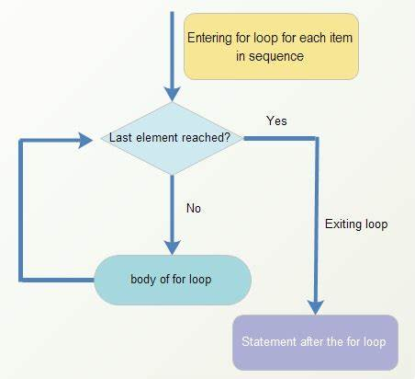
FOR LOOP FLOWCHART
You may also think of a for loop using the flowchart on the right

Slide 15
WHILE LOOP
What if we don’t know for sure how many times we want our loop to run?
That’s where the While Loop steps in
The while loop, rather than being based on a range, is based on a condition, and it will continue to loop until the condition is false
i = 20 while(i > 1): i = i // 2 print(i)

Slide 16
INFINITE LOOP
You may have noticed that this could allow for a condition that never turns false
This is called an infinite loop, and it’s bad news
The program will never stop running
There are a few instances where this can be helpful tho
#this is an infinite loop i = 10 while(i > 5): print("Yeah!")

Slide 17
WHILE LOOPS
While loops allow us more flexibility in the conditions that we want to be met for our loop to end
Any logical statements that could go into an If Statement can also go into a While Loop
These are also known as pre-condition loops
num = 5 guess = int(input("Guess a number between 1 and 10: ")) while(guess != num): guess = int(input("Incorrect, try again: ")) print("You got it!")

Slide 18
WHILE LOOPS
It is also worth noting that ANY For Loop can be written as a While Loop
Why have the For Loop at all?
#for loop for i in range(0, 100): print(i) #while loop i = 0 while i < 100: print(i) i = i + 1

Slide 19
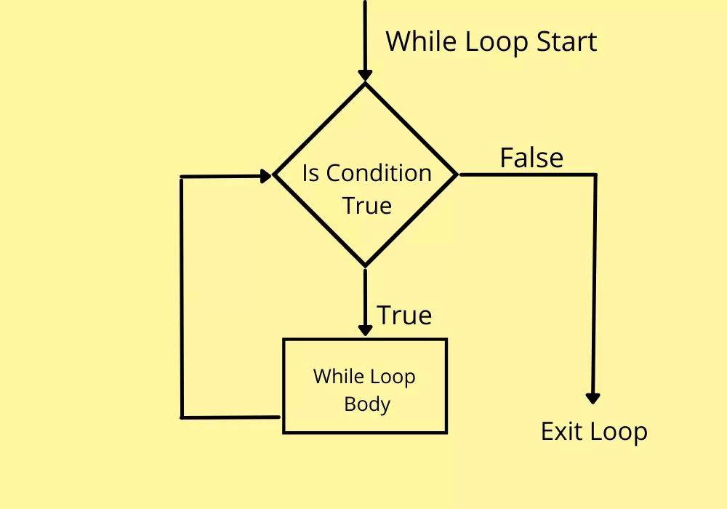
WHILE LOOPS
You can also think of While Loops using this flowchart

Slide 20
DO WHILE LOOPS
Do While Loops function similarly to While Loops
Instead of checking the condition first, the loop will run once, and then check the conditions to determine if it will loop again
These are relatively situational
num = 1 while(True): print(num) num = num+1 if num > 100: break

Slide 21
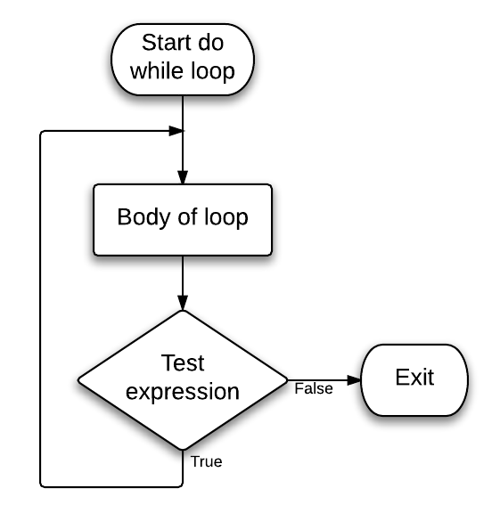
DO WHILE LOOPS
You can use the following flowchart to visualize the Do While Loop

Slide 22
PROGRAMMING ASSIGNMENT
You can find today’s programming assignment (PA B2-1) on the class Github Repository

